Slide 1


Big Data Analytics
NAVTTC Batch III

Slide 2
Basic Programming in Python
Week 01 – 02

Slide 3
Outline
Introduction
Python IDEs
First Program
Variables
Casting
User input

Slide 4
Introduction
Python is a high-level, general-purpose programming language.
It is an open-source, interpreted language.
It uses indentations to emphasize code readability.
It is used for:
  Web development
  Data analysis and machine learning
  Automation or scripting
  Software testing

Slide 5
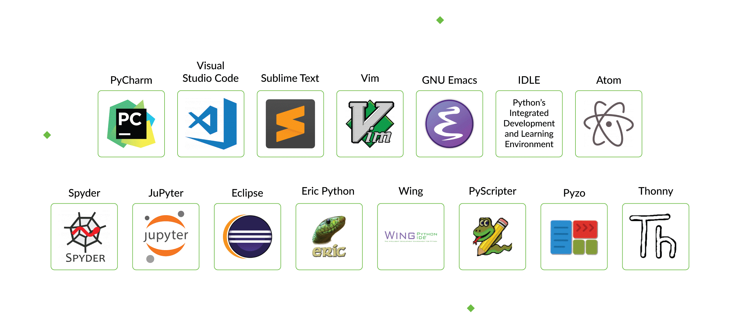
Python IDEs and Code Editors

Slide 6

First Python Program
The print() statement is used to print the given object to the terminal.
These two statements will print an imaginary dog on the terminal.
This statement will print 10 * on the terminal.
print("Hello world")

Slide 7
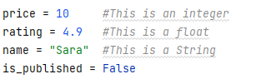
Variables
One of the most fundamental concepts in programming.
Variables are used to temporarily store data in a computer’s memory.
Creating Variable
  A variable is created the moment you first assign a value to it.
  Example

Slide 8
Task
Imagine you work in the university’s admission department. You have to enter the data for a student named Hamza Khan. He is 20 years old and he is a new student.

Slide 9
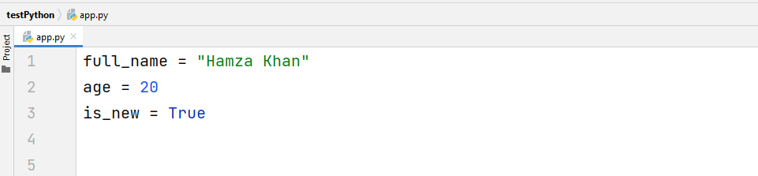
Task Solution

Slide 10
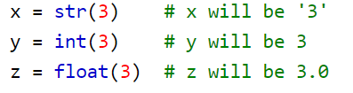
Casting
If you want to specify the data type of a variable, this can be done with casting.
Example

Slide 11
Getting User Input
Python provides us with an inbuilt function to read the input from the keyboard.
  input ( prompt )
input ( ): This function first takes the input from the user and then evaluates the expression, which means Python automatically identifies whether the user entered a string or a number or list. If the input provided is not correct then either syntax error or exception is raised by python. For example –
val = input("Enter your value: ")
print(val)

Slide 12
Task
Ask two questions from the user: the user’s name and their favorite sport.
Then print a message like, Ahmed likes football.

Slide 13
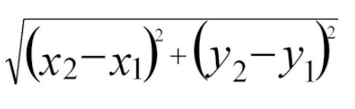
Task
Write a program to compute the distance between two points taking input from the user
Formula:
Write a program add.py that takes 2 numbers as command-line arguments and prints its sum

Slide 14
Python Strings
A string is a sequence of Unicode characters enclosed with quotation marks.

Slide 15
Outline
Creating a string
Accessing a character in a string
Change or delete a string
Python string operations
String formatting
String methods

Slide 16
Creating a String
Strings can be created by enclosing characters inside a single quote or double-quotes.
Even triple quotes can be used in Python but are generally used to represent multiline strings and docstrings.

Slide 17
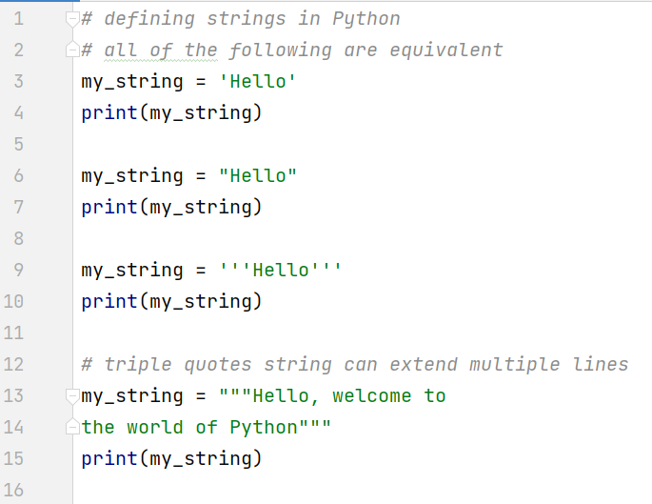
Creating a String

Slide 18
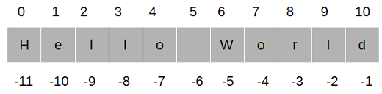
Accessing Characters in a String
We can access individual characters using indexing and a range of characters using slicing.
Index starts from 0. Trying to access a character out of the index range will raise an IndexError.
The index must be an integer. We can't use floats or other types, this will result in TypeError.
Python allows negative indexing for its sequences.
The index of -1 refers to the last item, -2 to the second last item, and so on.
We can access a range of items in a string by using the slicing operator :(colon)

Slide 19
Accessing Characters in a String
#Accessing string characters in Python
str = 'Big Data Analytics'
print('str = ', str)
#first character
print('str[0] = ', str[0])
#last character
print('str[-1] = ', str[-1])
#slicing 2nd to 5th character
print('str[1:5] = ', str[1:5])
#slicing 6th to 2nd last character
print('str[5:-2] = ', str[5:-2])

Slide 20
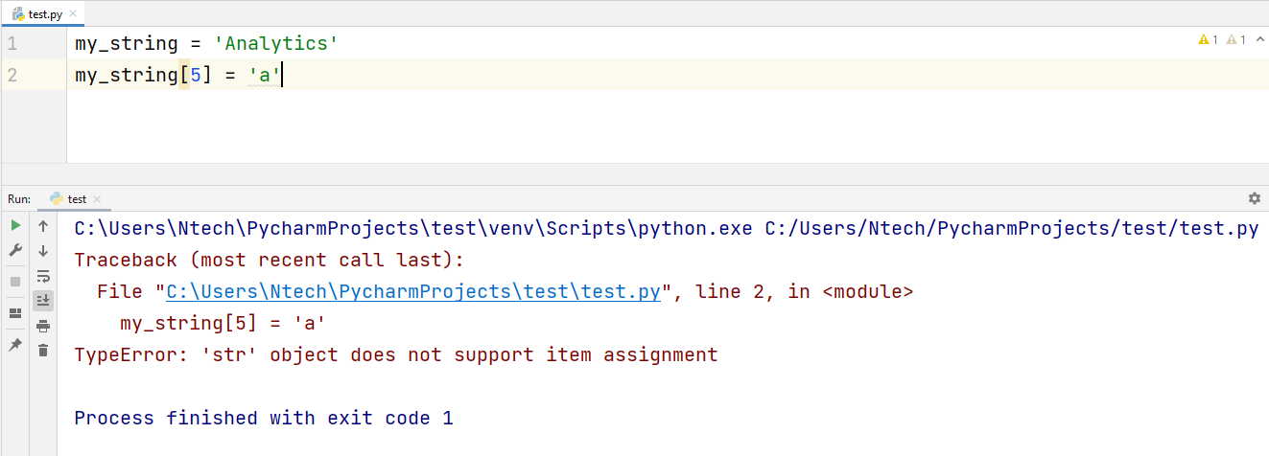
Change or Delete a String
Strings are immutable.
This means that elements of a string cannot be changed once they have been assigned. We can simply reassign different strings to the same name.

Slide 21
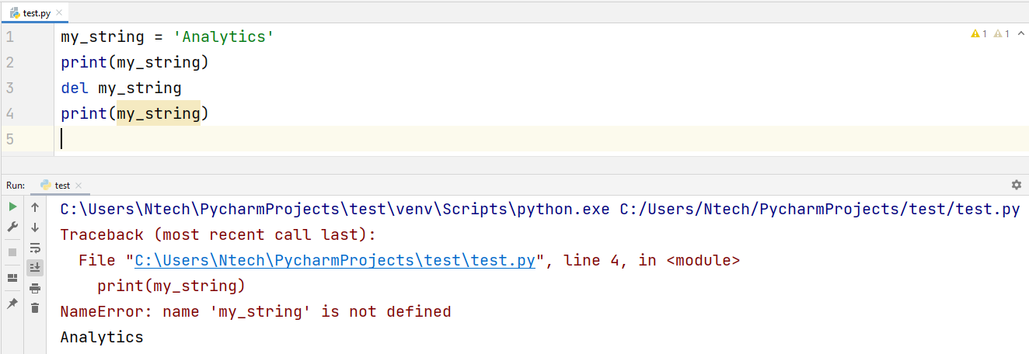
Change or Delete a String
We cannot delete or remove characters from a string. But deleting the string entirely is possible using the del keyword.

Slide 22
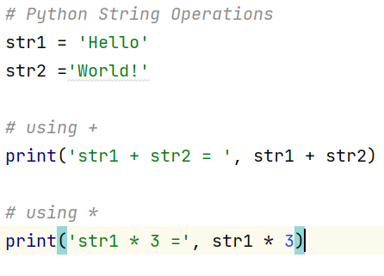
Python String Operations
Concatenation of Two or More Strings
  Joining two or more strings into a single one is called concatenation.
  The + operator does this in Python. Simply writing two-string literals together also concatenates them.
  The * operator can be used to repeat the string a given number of times.

Slide 23
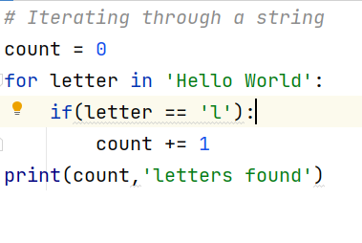
Python String Operations
Iterating Through a String
  We can iterate through a string using a for loop.
  Here is an example to count the number of 'l's in a string.

Slide 24

Python String Operations
String Membership Test
  We can test if a substring exists within a string or not, using the keyword in.

Slide 25
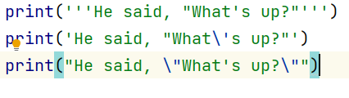
Python String Formatting
Escape Sequence
  If we want to print a text like He said, "What's there?", we can neither use single quotes nor double-quotes.
  This will result in a SyntaxError as the text itself contains both single and double-quotes.
  One way to get around this problem is to use triple quotes. Alternatively, we can use escape sequences.

Slide 26
Python String Formatting
The format() Method
  The format() method that is available with the string object is very versatile and powerful in formatting strings.
  Format strings contain curly braces {} as placeholders or replacement fields that get replaced.

Slide 27
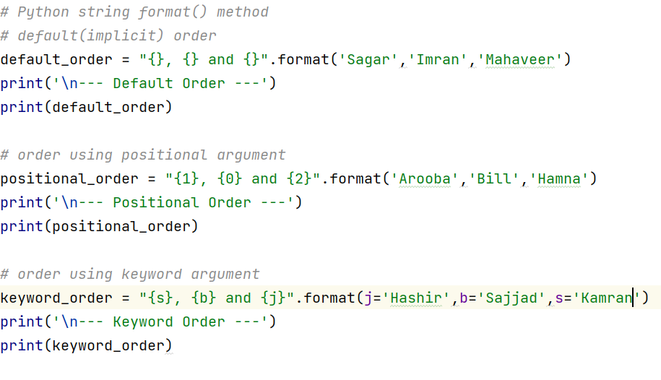
Python String Formatting
The format() Method Example

Slide 28
Task
Ask the user for his first and last names. Then print the statement: FirstName [Last Name] is a programmer.

Slide 29
Python String Methods
capitalize() | Converts the first character of the string to a capital (uppercase) letter
casefold() | Implements caseless string matching
center() | Pad the string with the specified character.
count() | Returns the number of occurrences of a substring in the string.
encode() | Encodes strings with the specified encoded scheme
endswith() | Returns “True” if a string ends with the given suffix
expandtabs() | Specifies the amount of space to be substituted with the “\t” symbol in the string

Slide 30
Python String Methods
find() | Returns the lowest index of the substring if it is found
format() | Formats the string for printing it to console
format_map() | Formats specified values in a string using a dictionary
index() | Returns the position of the first occurrence of a substring in a string
isalnum() | Checks whether all the characters in a given string is alphanumeric or not
isalpha() | Returns “True” if all characters in the string are alphabets
isdecimal() | Returns true if all characters in a string are decimal
isdigit() | Returns “True” if all characters in the string are digits
isidentifier() | Check whether a string is a valid identifier or not

Slide 31
Python String Methods
islower() | Checks if all characters in the string are lowercase
isnumeric() | Returns “True” if all characters in the string are numeric characters
isprintable() | Returns “True” if all characters in the string are printable or the string is empty
isspace() | Returns “True” if all characters in the string are whitespace characters
istitle() | Returns “True” if the string is a title cased string
isupper() | Checks if all characters in the string are uppercase
join() | Returns a concatenated String
ljust() | Left aligns the string according to the width specified
lower() | Converts all uppercase characters in a string into lowercase
lstrip() | Returns the string with leading characters removed

Slide 32
Python String Methods
maketrans() | Returns a translation table
partition() | Splits the string at the first occurrence of the separator
replace() | Replaces all occurrences of a substring with another substring
rfind() | Returns the highest index of the substring
rindex() | Returns the highest index of the substring inside the string
rjust() | Right aligns the string according to the width specified
rpartition() | Split the given string into three parts
rsplit() | Split the string from the right by the specified separator
rstrip() | Removes trailing characters
splitlines() | Split the lines at line boundaries
startswith() | Returns “True” if a string starts with the given prefix
strip() | Returns the string with both leading and trailing characters
swapcase() | Converts all uppercase characters to lowercase and vice versa

Slide 33
Python String Methods
title() | Convert string to title case
translate() | Modify string according to given translation mappings
upper() | Converts all lowercase characters in a string into uppercase
zfill() | Returns a copy of the string with ‘0’ characters padded to the left side of the string

Slide 34
Python Operators
Operators are used for performing operations on variables and values.

Slide 35
Types of Operators
Python divides the operators into the following groups:
  Arithmetic operators
  Assignment operators
  Comparison operators
  Logical operators
  Identity operators
  Membership operators
  Bitwise operators

Slide 36
Python Arithmetic Operators
Arithmetic operators are used with numeric values to perform common mathematical operations:
Operator | Name | Example
+ | Addition | x + y
- | Subtraction | x - y
* | Multiplication | x * y
/ | Division | x / y
% | Modulus | x % y
** | Exponentiation | x ** y
// | Floor division | x // y

Slide 37
Operators Precedence
x = 10 + 3 * 2
print(x)
Python Operators Precedence Rule – PEMDAS
  P – Parentheses.
  E – Exponentiation.
  M – Multiplication.
  D – Division.
  A – Addition.
  S – Subtraction.

Slide 38
Task
Solve x = (2+3) * 10 -3 and print it on the terminal.

Slide 39
Python Assignment Operators
Assignment operators are used for assigning values to variables:
Operator | Example | Same As
= | x = 5 | x = 5
+= | x += 3 | x = x + 3
-= | x -= 3 | x = x - 3
*= | x *= 3 | x = x * 3
/= | x /= 3 | x = x / 3
%= | x %= 3 | x = x % 3
//= | x //= 3 | x = x // 3
**= | x **= 3 | x = x ** 3
&= | x &= 3 | x = x & 3
|= | x |= 3 | x = x | 3
^= | x ^= 3 | x = x ^ 3
>>= | x >>= 3 | x = x >> 3
<<= | x <<= 3 | x = x << 3

Slide 40
Python Comparison Operators
Comparison operators are used for comparing two values:
Operator | Name | Example
== | Equal | x == y
!= | Not equal | x != y
> | Greater than | x > y
< | Less than | x < y
>= | Greater than or equal to | x >= y
<= | Less than or equal to | x <= y

Slide 41
Python Logical Operators
Logical operators are used for combining conditional statements:
Operator | Description | Example
and | Returns True if both statements are true | x < 5 and x < 10
or | Returns True if one of the statements is true | x < 5 or x < 4
not | Reverse the result, returns False if the result is true | not(x < 5 and x < 10)

Slide 42
Python Identity Operators
Identity operators are used to compare the objects, not if they are equal, but if they are actually the same object, with the same memory location:
Operator | Description | Example
is | Returns True if both variables are the same object | x is y
is not | Returns True if both variables are not the same object | x is not y

Slide 43
Task
Price of a house is 1M Rupees
If the buyer has good credit, they need to put down 10%.
Otherwise, they need to put down 20%.

